Slide 1
National Emergency Response Information System Overview
April 2025

Slide 2
Table of Contents
01
What is NERIS? Purpose, Concept, Launch
02
Key Features Discussion on incident features and modernization examples
03
.
Onboarding for Local Fire Departments What you need to know to get ready to onboard onto NERIS.
04
NFIRS Sunset Understanding how to prepare for the NFIRS Sunset
Notes:
Adapt for Audience

Slide 3
What is NERIS
1

Slide 4
The goal of NERIS is to empower the local fire and emergency services community by equipping them with near real-time information and analytic tools that support data informed decision-making for enhanced preparedness and response to incidents involving all hazards.

Slide 5
The Focus of NERIS:
RISK
DEPLOYMENT
PERFORMANCE
Community Vulnerability
Structures in First Due
Code Adoption
Evolving Weather Hazards
Resource Allocation
Monitor Staffing Levels
Station & Unit Capacity
Geographic Areas of Concern
Response Time
Effective Crew Size & Response Force
Inform Training Needs

Slide 6
Fundamentally, NERIS
COLLECT
INTEGRATE
MANAGE
ANALYZE
SHARE
CAD/RMS
NERIS Collection App
External Data Sources
GIS, Weather, Infrastructure, Census
Secure, Cloud-Based Data
Public Data Dictionary
Data Enrichment
Analytics & Dashboards
State Fire Marshals
USFA & Other Federal Agencies
Local Departments & Partners
Notes:
NERIS Fundamentals
COLLECT
CAD/RMS
NERIS Collection App
INTEGRATE
External Data Sources
GIS, Weather, Infrastructure, Census
MANAGE
Secure, Cloud-Based Data
Public Data Dictionary
ANALYZE
Data Enrichment
Analytics & Dashboards
SHARE
State Fire Marshals
USFA & Federal Agencies
Local Departments & Partners

Slide 7
NERIS Perception
What people have been able to see/touch/ interact with has been limited as the system has been developed
Analytics The value return on the data collected. Provides intelligence to help improve prevention efforts and emergency response
Data Schemas The elements we collect. Designed to describe the work done by the fire service to help the people in the communities they protect.
API The API is the data hub for the system allowing the movement of data both internally (within NERIS) and externally (to/from entities).
System Architecture The foundation of the system – built on an elastic framework for reliability and scalability.
Notes:
Highlight the depth and important of this project and the role of communication and training in bridging the gap that there is so much more to the system than meets the eye. It is a fine line but carries a tremendous responsibly and we need everyone here to help.

Slide 8
Interconnected Intelligence
Powered by the National Emergency Response Information System (NERIS)
EMPOWRING EFFECTIVE EMERGENCY RESPONSE
Intelligence
NERIS DATA COLLECTION, INTEGRATION, MANAGEMENT AND ANALYSIS ENVIRONMENT
NERIS Data Framework & API Infrastructure
DATA ECOSYSTEM
Best Available External Data as APIs from:
Local CAD
Local RMS
US Forest Service/NIFC
Satellite Imagery
National Weather Service
Wildfire Detection Sensors
Wearable Sensors
Suppression Sensors
Notes:
NERIS is more than a database.
For ease of data transfer It is designed to connect to department infrastructure and once the data arrives, NERIS augments incident data with other elements such as weather, parcel information, field sensor data, and other sets as we can integrate them. NERIS will also link with the secondary schemas such as CRR.
This moves to the middle box – which is the analytics engine. It about putting that data to use in dashboards, running models on data, sensing outliers, producing reports.
Which sets up box 3 (top box) – empowering federal, state, local, and tribal leaders to use this information – or intelligence (data with context) to make decisions that can improve the services they provide to the citizens they protect.

Slide 9
Building With the Fire Service
OCT-DEC 2023
MAR 2024
AUG 2024
NOV 2024
Data Framework & Architecture Development
Prototype Testing
Beta Testing
Version 1 Release
Six departments, representing a cross section of agency sizes and complexities, were charged with testing and evaluating the prototype NERIS.
Building on feedback prototype testing, another 56 fire departments were onboarded into the beta NERIS platform and began identifying issues and opportunities for functional improvement.
Version 1 of NERIS is launched! A total of 173 fire departments were onboarded onto V1 NERIS and began using the system to report and share incident data.
Local stakeholders representing a national perspective provided requirements in the development of the NERIS data framework, schemas, and the open solutions architecture. National engagement on the data framework resulted in 1,600 comments.

Slide 10
Key Features and Benefits of NERIS
2

Slide 11
Data-informed leadership will become the gold standard for the fire service
Data is a living resource that captures the full complexity of the incidents we respond to and the communities we serve.
Photo: SBCFD
Notes:
Data isn’t naturally a firefighter’s favorite topic. Fire Chiefs don’t even see data and analytics as an ally to solving local problems, but rather something to be tolerated and overcome. We're on the verge of changing that narrative and beginning a new chapter in leadership for the fire service, as data-informed leadership becomes not just the gold standard, but the norm. In its ideal state, data is a living resource that captures the full complexity of the incidents we respond to and the communities we serve. We are fortunate to be able to access definitive data about almost anything at our fingertips – why not enhance and leverage our emergency response capabilities in a similar fashion?
For those I haven’t had the pleasure of meeting, I was honored to serve as a career firefighter for 26 years, 15 of which as Chief of Department. I can tell you: for all the hype, data is only as valuable as the systems you build to manage it—and, of course, the training and motivation of the people putting it into that system.

Slide 12
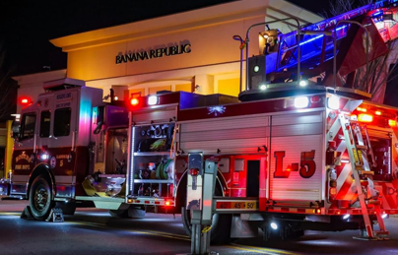
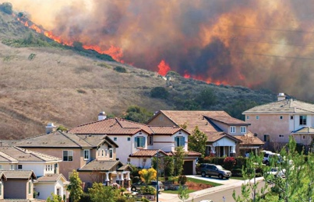
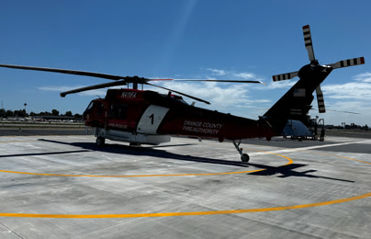
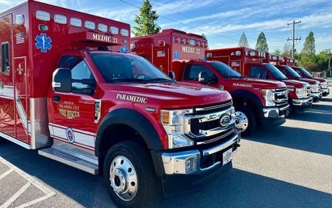
Matching Risk & Resources
Notes:
With data, we can:
Identify patterns that help us learn from every response
Shorten the gap between emerging hazards and the research to help understand how to mitigate risk
Utilize post-incident insights to reveal the effectiveness of resource allocation and response times

Slide 13
NERIS Incident Data
Secure & Scalable Architecture: Cloud-hosted open solution built for reliability, security, and easy expansion.
Standards-Based Data Sharing: Public, interoperable API infrastructure ensures seamless data exchange.
GIS-Driven Precision: Leveraging location services to provide accurate, actionable intelligence for responders.
Public NERIS Data Dictionary: Transparent, standardized data definitions available to all stakeholders.
Enhanced Intelligence: Integrates best available external data sources to boost situational awareness.
Operational Efficiency: Reduces firefighter data entry burden by integrating:
Computer-Aided Dispatch (CAD)
Records Management Systems (RMS)
Notes:
Core Functionality
Secure & Scalable Architecture: Cloud-hosted open solution built for reliability, security, and easy expansion.
Standards-Based Data Sharing: Public, interoperable API infrastructure ensures seamless data exchange.
GIS-Driven Precision: Leveraging location services to provide accurate, actionable intelligence for responders.
Public NERIS Data Dictionary: Transparent, standardized data definitions available to all stakeholders.
Enhanced Intelligence: Integrates best available external data sources to boost situational awareness.
Operational Efficiency: Reduces firefighter data entry burden by integrating:
Computer-Aided Dispatch (CAD)
Records Management Systems (RMS)

Slide 14
NERIS Open Data
Open Data Product
What’s included?
The foundation for national fire analytics — powered by the first comprehensive, geospatially enabled list of U.S. fire departments
Freely available public data as a service, hosted on the NERIS website
Attribute levels mirror existing open NFIRS datasets
Delivered in open formats like GeoJSON and Esri Feature Services
Coming soon in 2025
Fire department location
Fire station locations linked to FDs
Fire department service boundaries
Core Fire & EMS Department Data
All-Hazards incident data shared to NERIS
All modules from the NERIS data schemas
No personally identified data or open text narrative fields included
NERIS Incident Data

Slide 15
Data Integration
People, Places, and Infrastructure
Parcel Information
Incorporate essential census-level data such as building types, ages, transportation infrastructure, and demographic details directly into incident records, enriching emergency response context.
Critical property data—including land value, improved value, year built, square footage, and acreage—for every incident location, eliminating manual entry and enhancing situational awareness.
Weather
Hazards and Current Conditions
Automated capture of weather conditions—temperature, humidity, wind, precipitation—at the time of each emergency call, streamlining data collection and freeing responders to focus on critical tasks.
Combine hazard exposure, current risk factors, and conditions to inform proactive emergency planning, targeted community risk reduction, and effective after-action analyses. Enhance efficiency by utilizing recent incident data and inter-agency resource information.
Notes:
Data Integration
Parcel Insights
Automatically integrate critical parcel data—land value, improved value, year built, square footage, and acreage—for every incident location, eliminating manual entry and enhancing situational awareness.
Real-Time Weather
Instantly capture weather conditions—temperature, humidity, wind, precipitation—at the time of each emergency call, streamlining data collection and freeing responders to focus on critical tasks.
People, Places & Infrastructure
Incorporate essential census-level data such as building types, ages, transportation infrastructure, and demographic details directly into incident records, enriching emergency response context.
Hazards & Conditions
Combine hazard exposure, current risk factors, and conditions to inform proactive emergency planning, targeted community risk reduction, and effective after-action analyses. Enhance efficiency by utilizing recent incident data and inter-agency resource information.

Slide 16
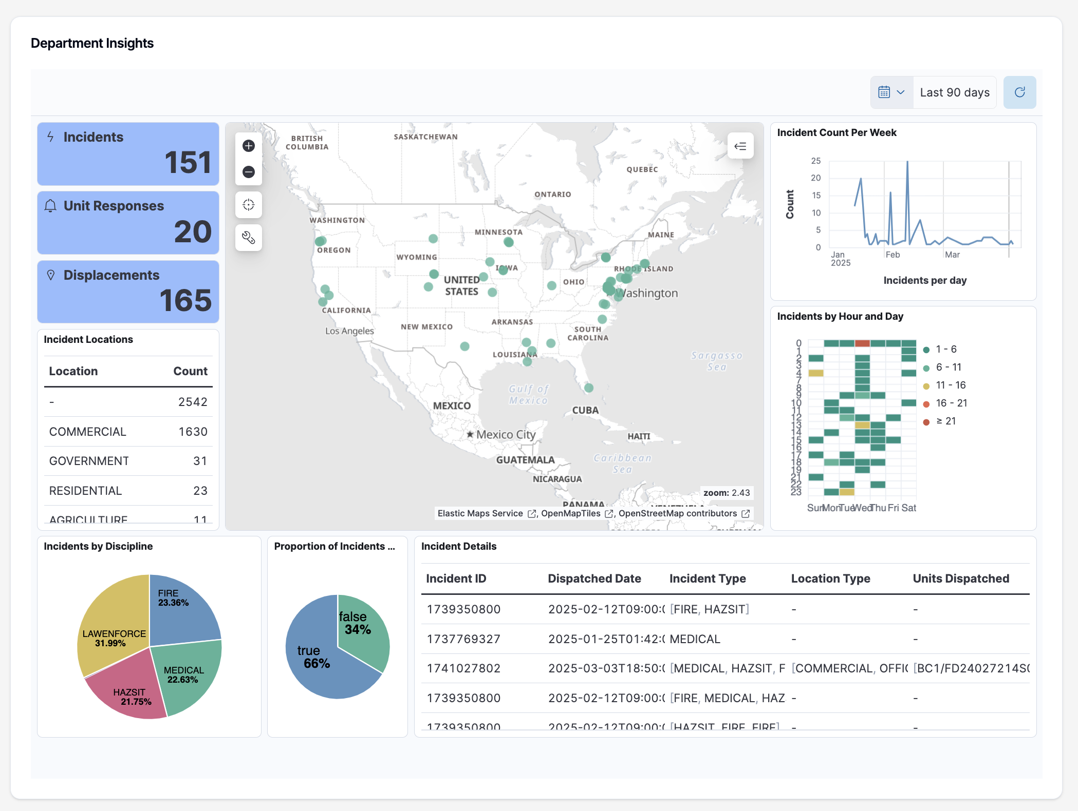
NERIS Analytics: Immediate Insights
Participating departments gain instant access to key analytics and metrics.
NERIS enhances data by integrating essential data and information for better intelligence.
The analytics menu for local fire & EMS departments will continue to expand and improve over time.
Notes:
One of the primary benefits of NERIS is to allow data to work for the firefighters, company officers, fire chiefs and other decision makers within fire organizations big and small, paid and volunteer. These departments will, many of which for the first time, be able to consume analytics and metrics about their responses to know in a time sensitive manner about what is going on throughout their jurisdictions. These dashboards will be free and customizable for agencies. What you see right here is a glimpse of the interactive and dynamic analytics already developed and what will be expanded, improved and enhanced as we continue to work.

Slide 17
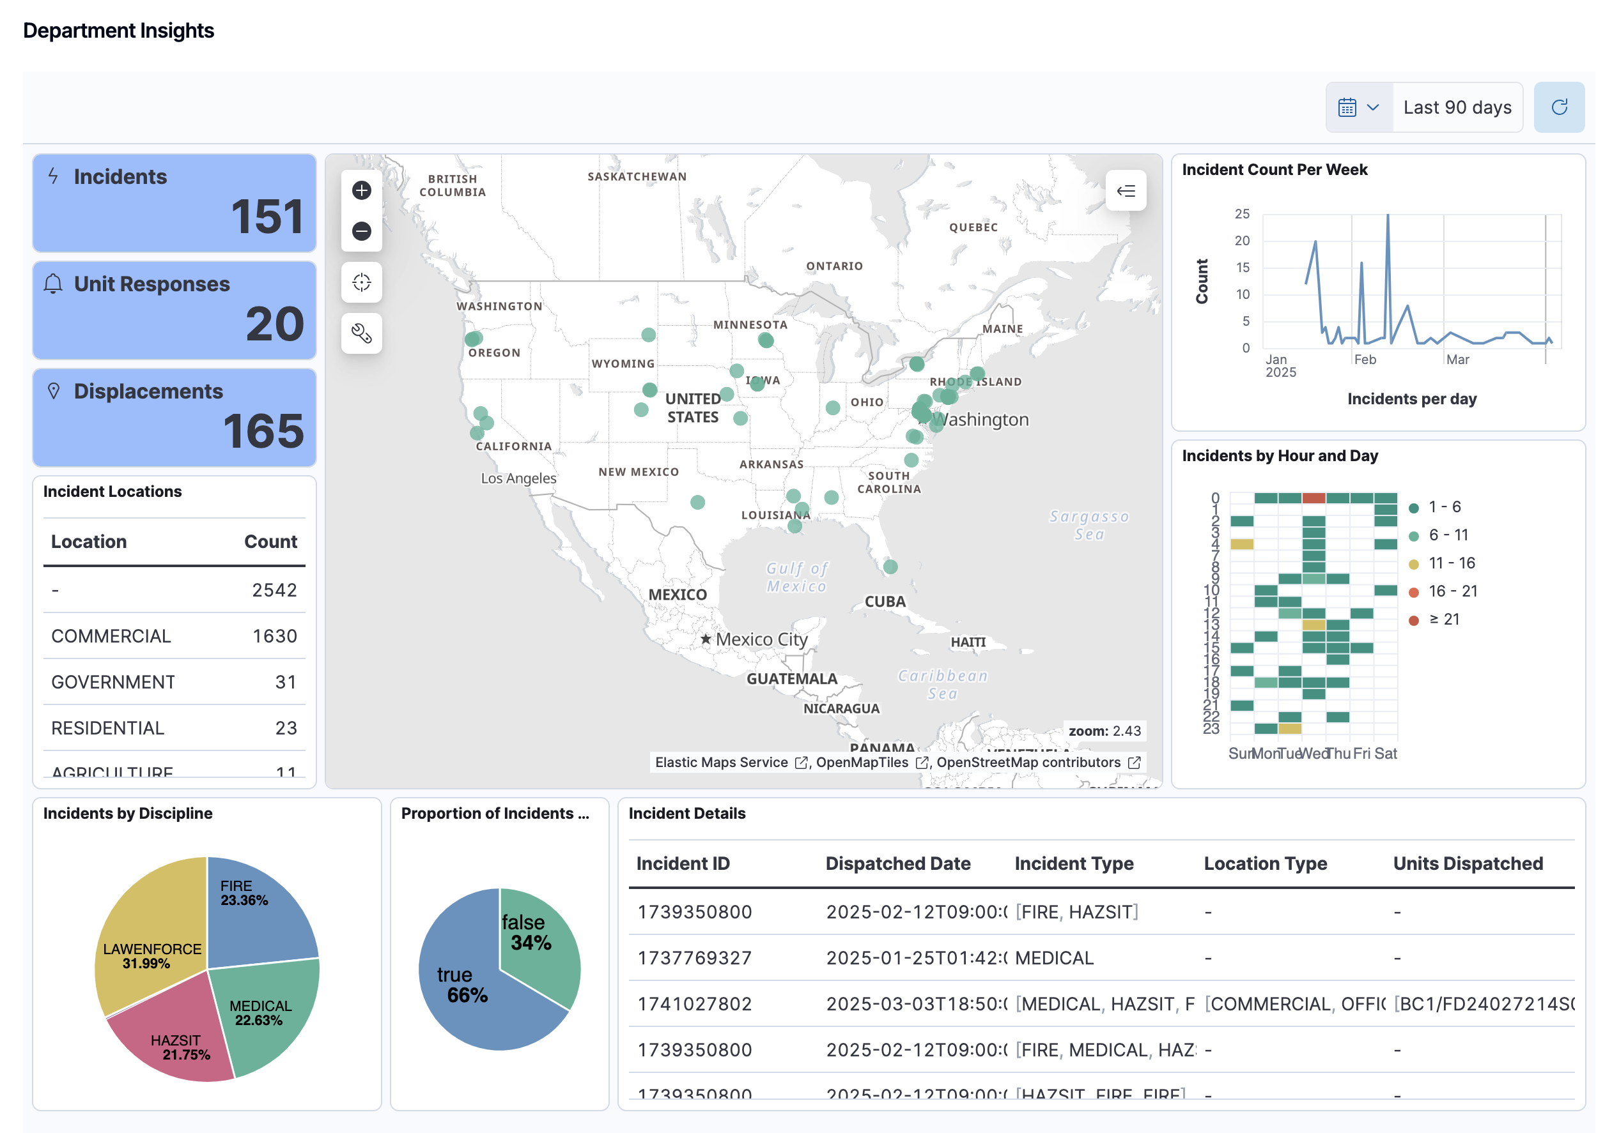
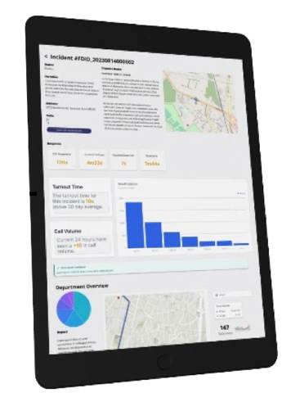
Future Fire Department Fingerprint
1
4
Community Demographics
Early Detection Sensor Data
Current & Future Risk
NERIS Intelligence: Performance, Actions & Tactics, Community risk
NERIS Fire Department Profile
2
5
3

Slide 18
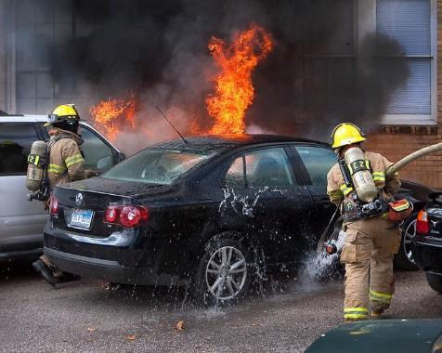
What Improvements will NERIS Offer?
Enhanced Flexibility with Multi-Hazard Incident Reporting
Comprehensive Reporting: Move from a single-category system to a model supporting up to three incident types. This reflects the complexity often faced by fire services in real-world scenarios.
For Firefighters: Simplify reporting by selecting incident types that accurately depict the scene, eliminating the guesswork of single-category constraints.
For Chiefs/Data Analysts: Reduce reliance on interpreting free-text narratives, streamlining data analysis.
NFIRS historically limited incident type selection to only one incident type,
whereas NERIS allows multiple types per incident.

Slide 19
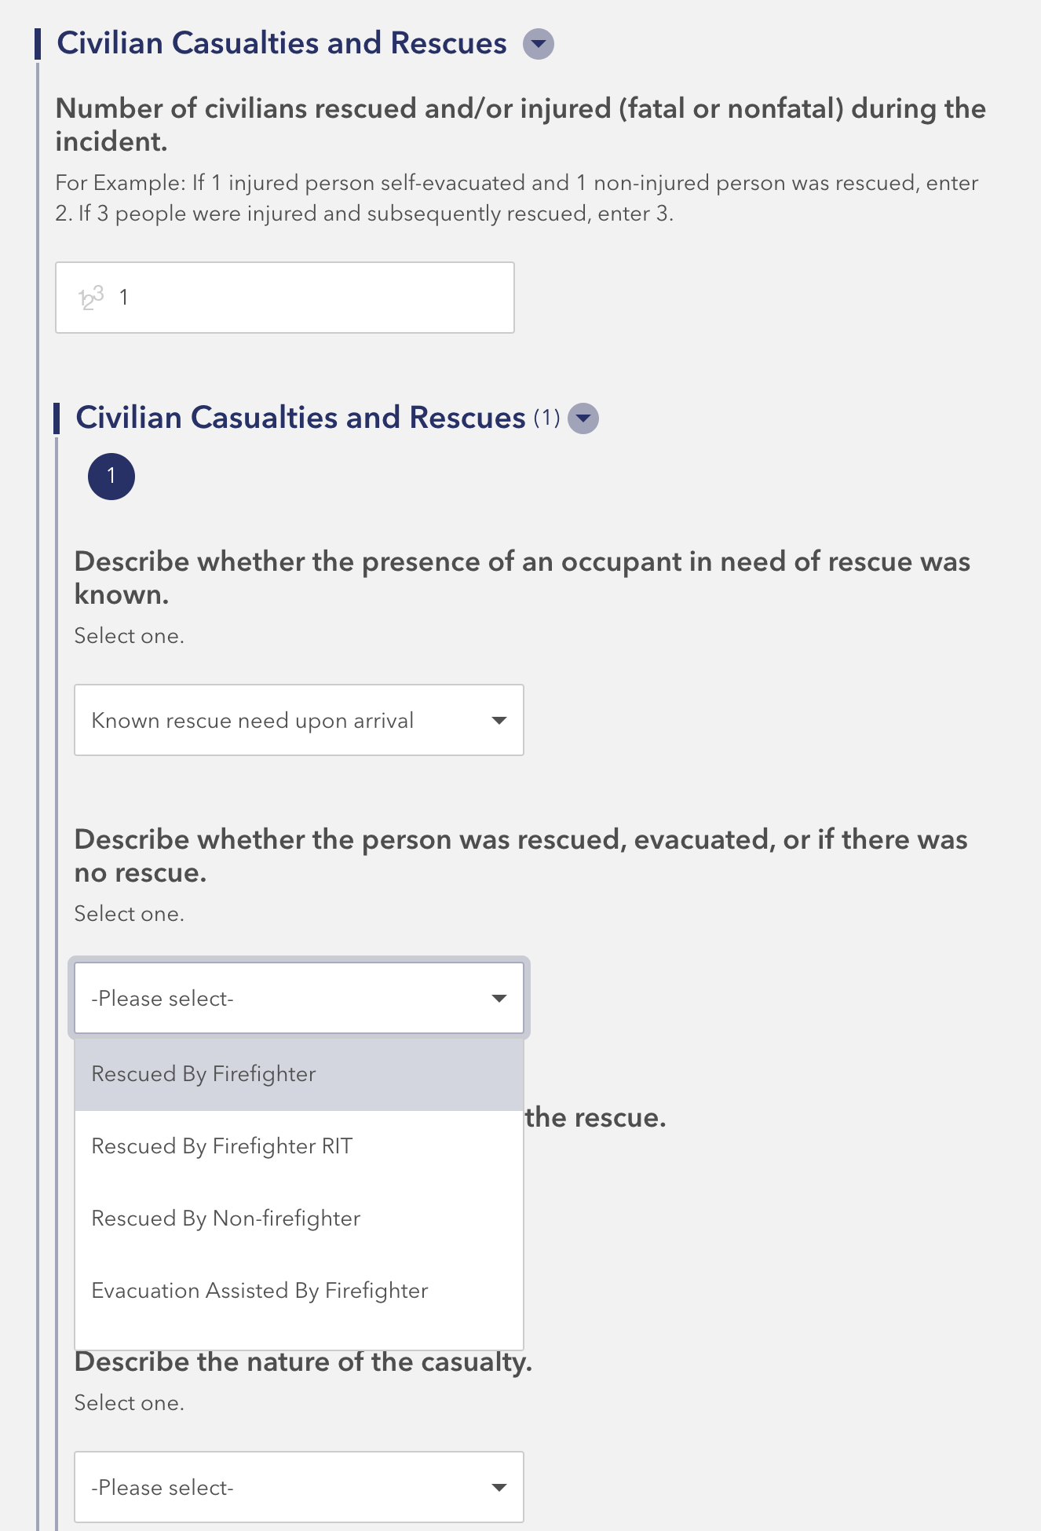
What Improvements will NERIS Offer?
Enhanced Reporting for Actions, Tactics, and Incident Outcomes
Actions and Tactics: Modernized to capture comprehensive operational data including suppression techniques, ventilation efforts, and on-scene contamination reduction tactics.
Metrics on Rescues, Casualties, and Maydays: Detailed tracking of key metrics reflecting the vital efforts of firefighters during emergency responses.

Slide 20
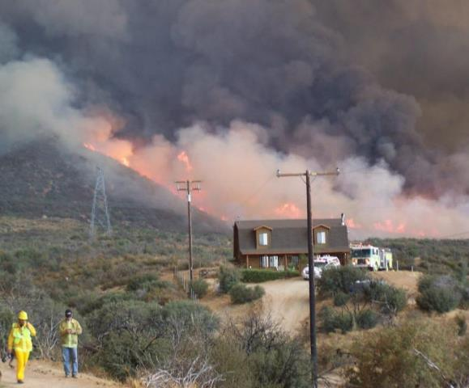
What Improvements will NERIS Offer?
Enhanced Emerging Hazards and Structure Exposures:
Emerging Hazards: This module will enable the system to evolve to the dynamic environments we operate in, enabling data collection of evolving threats.
Structure Exposures: Entered as a straightforward addition to the original incident report, streamlining entry even in complex scenarios like urban conflagrations and the wildland-urban interface. This will reduce report completion time and improve accuracy on complex fire incidents.

Slide 21
Onboarding for Local Fire Departments
3

Slide 22
NERIS Onboarding
Two Phase Process
1
2
Creating Your Account
Reporting
Fire departments can add/update attribute information after they activate their node in NERIS.
A) If using the NERIS collection app - submit when ready.
B) If using a third-party RMS – switch after your RMS is ready

Slide 23
Vendor Readiness
The NERIS-compatible badge signifies that a vendor’s software is capable of data exchange with the NERIS platform.
To earn a NERIS compatibility badge, a vendor must:
Create an integration between their software and NERIS
Submit a new incident in the test environment to the FSRI Fire Department
Capture the unique incident number and submit an update to the incident that was created
Establish a station and add a unit to the FSRI Fire Department

Slide 24
NERIS API Integration
An Application Programming Interface (API) acts as the connection between software or systems that allows them to communicate with each other.
Why is this so important?
Allows connection between third-party RMS and CAD into NERIS.
Will set the stage for future integrations from NERIS into other systems.
Eliminates the need for emailing and uploading of files for incident reporting.
Sets hard parameters on what data elements and information enter NERIS.
Get, Put,
Post, Delete
HTTP Request
CLIENT
NERIS API Gateway
HTTP Response
Incident Payload
SERVER
JSON

Slide 25
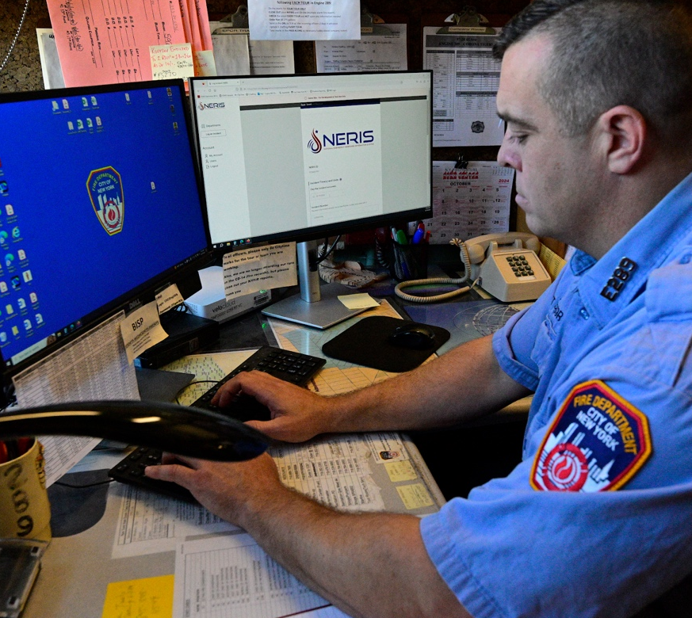
Onboarding Information
Department demographics
GIS boundaries of district and any other region sets
Station names and addresses
Unit and apparatus inventory
CAD designations, unit types, and unit level staffing
Department services provided
Fire, EMS, investigative, CRR, etc.
Department relationship information
Memberships and mutual/automatic/contract agreements
Photo: NYFD
Notes:
Department relationship information (mutual/automatic/contract agreements)
Membership is XX department is a part of a larger YY departments – often a volunteer dept inside a career department

Slide 26
NERIS Ready: 2025
Project Manager
Establish a primary person of contact
Department Details & GIS
Obtain boundary and response area GIS layers
Detailed information you’ll need includes unit information, station addresses, minimum staffing and department attributes like ISO rating, accreditation status, etc.
Training, Orientation, & Awareness
Begin to push training materials about NERIS and the importance of data inputs to your members
Share information about NERIS with neighboring agencies

Slide 27
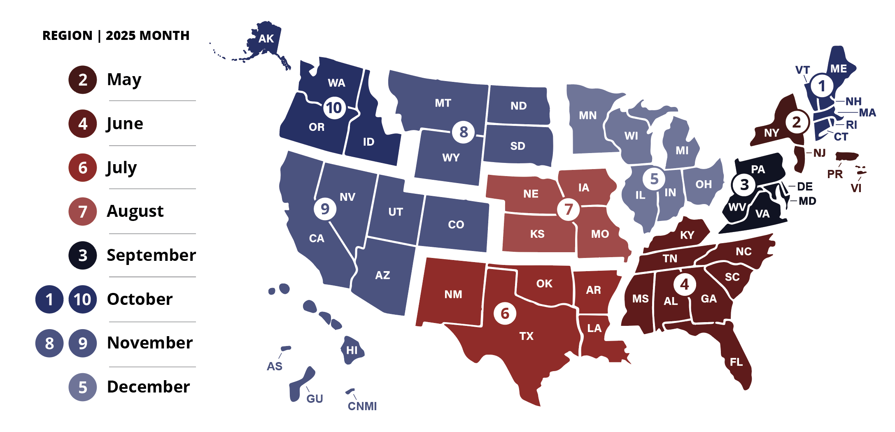
2025 Onboarding Schedule

Slide 28
NFIRS Sunset
4

Slide 29
NFIRS Sunset Basics
NFIRS
Planned for sunset and decommissioning in early 2026.
NFIRS Public Data Release (PDR) on OpenFEMA
Cleaned and processed annual, national data set made publicly available.
Not full, raw data.
Data currently available for 1980-2023.
Geospatial NFIRS PDR data also available for 2014-2023.
Data for 2024 and 2025 will be packaged and released on OpenFEMA.
Link: https://www.fema.gov/about/openfema/data-sets/fema-usfa-nfirs-annual-data
NERIS will not consume or connect with historical NFIRS data
More Information: https://www.usfa.fema.gov/nfirs/about/sunset/index.html

Slide 30
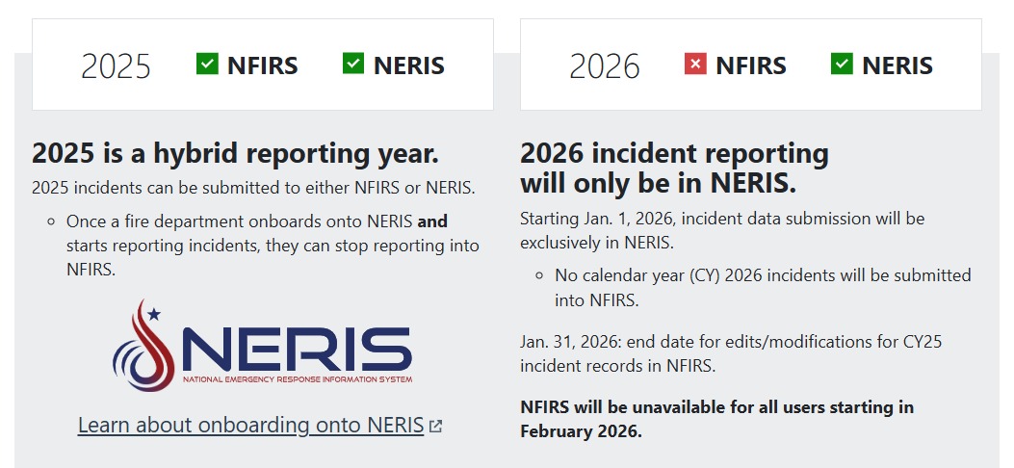
NFIRS Sunset Essentials

Slide 31
NFIRS Data Ownership
Entities contributing data to NFIRS retain ownership of their data.
NFIRS is not authorized to serve as an entity’s system of record in fulfilling their local jurisdiction’s records retention or storage solution.
“The data collected and input into NFIRS by the local fire departments and states belongs the specific users; FEMA/USFA does not have access to this information other than those staff who maintain the system. Therefore, historical data including PII are kept indefinitely for use in longitudinal analyses by those fire departments that own the data.”
Privacy Impact Assessment for the National Fire Incident Reporting System (NFIRS)DHS/FEMA/PIA-044

Slide 32
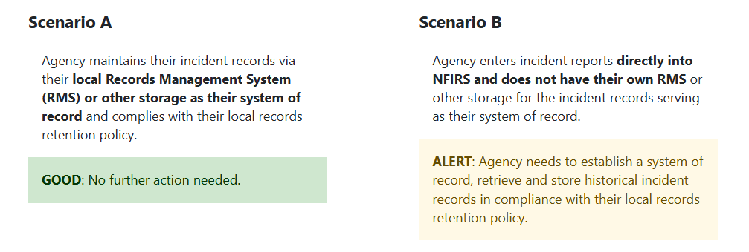
Records Retention Guidance for Local Fire Departments

Slide 33
Guidance for Scenario B: Performing Historical NFIRS Records Retrieval
Conduct a NFIRS Bulk data export for all years required to comply with your local records retention policy:
Maximum one-year increments
Maximum ~750,000 records
One export at a time
Access the NFIRS Data Warehouse to complete records retrieval:
Excel Export
Max ~200,000 rows
Limited data fields
Basic Fire, Structure Fire, Wildland modules
Be sure to complete retrieval of your Historical NFIRS records well in advance of the NFIRS sunset date.
Recommend completing all prior years needed before Nov. 2025, except for your 2025 records.

Slide 34
Call to Action: Records Retrieval
Ensure fire departments understand their local records retention policies and confirm how they are implementing and complying with those policies for fire incident reports/records.
Communicate with your local fire departments
Determine which agencies are “at risk” and may need to download their historical incident records
Evaluate your state database to determine if there are any data gaps
Establish a download schedule to meet your local or state records retention requirements and policy

Slide 35
Review
Local fire departments retain the ownership and responsibility to maintain their incident records in accordance with their local, and/or state retention policies.
If a state maintains a state-wide incident database, the state is responsible to maintain records in accordance with the state records retention schedule.

Slide 36
Thank you.
FAQS: HTTPS://WWW.USFA.FEMA.GOV/NFIRS/NERIS/ABOUT-NERIS | NFIRS Sunset: https://www.usfa.fema.gov/nfirs/about/sunset/index.html
WEBSITE: HTTPS://FSRI.ORG/PROGRAMS/NERIS | VIDEO Library: https://vimeo.com/nerisdata
CONTACT US: NERIS@UL.ORG

